Slide 1
Sales Analytics Dashboard — Power BI Project
By: Divyam Mahant Tools Used: Power BI, DAX, Data Modeling, Data Visualization
Mentor: CoachX.live

Slide 2
Problem Statement
To analyze sales performance across categories, customers, regions, and shipping modes, and provide insights to improve overall profitability and business decisions.

Slide 3
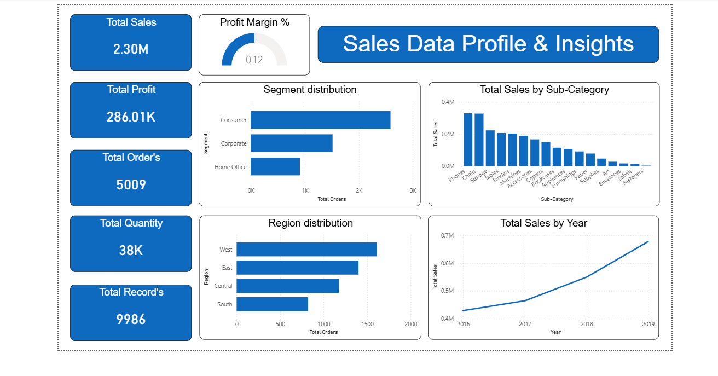
Dataset Description
Orders dataset including Sales, Profit, Discount, Quantity
4 Regions, 3 Customer Segments, 17 Sub-Categories
Time period: Multiple years of business data
100% clean data → no missing values

Slide 4
Data Overview Insights
West region generates highest sales
Consumer segment has maximum order count
Phones and Chairs highest selling sub-categories
Steady yearly growth visible in sales trend
Profit varies strongly between product types

Slide 5
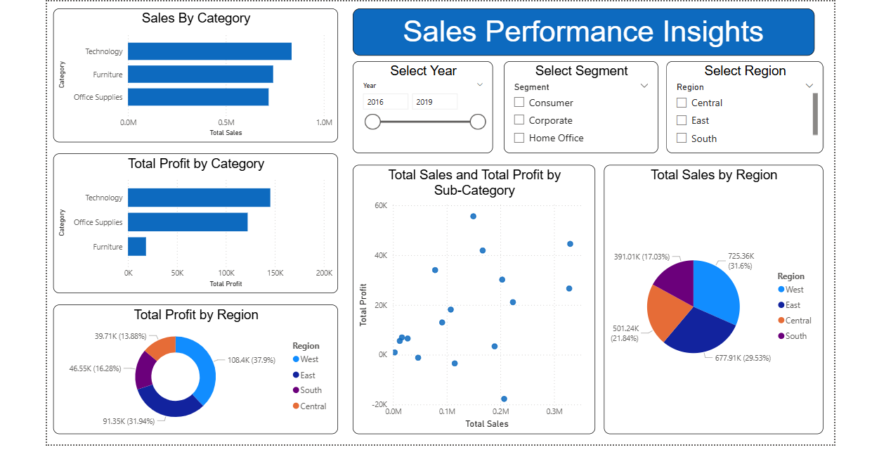
Sales Insights
Technology leads in both sales & profit
Furniture high sales but low profit → costing issue
West region #1 in revenue contribution
Central & South need focus to improve performance
Some products generate revenue but low profit → discount impact

Slide 6
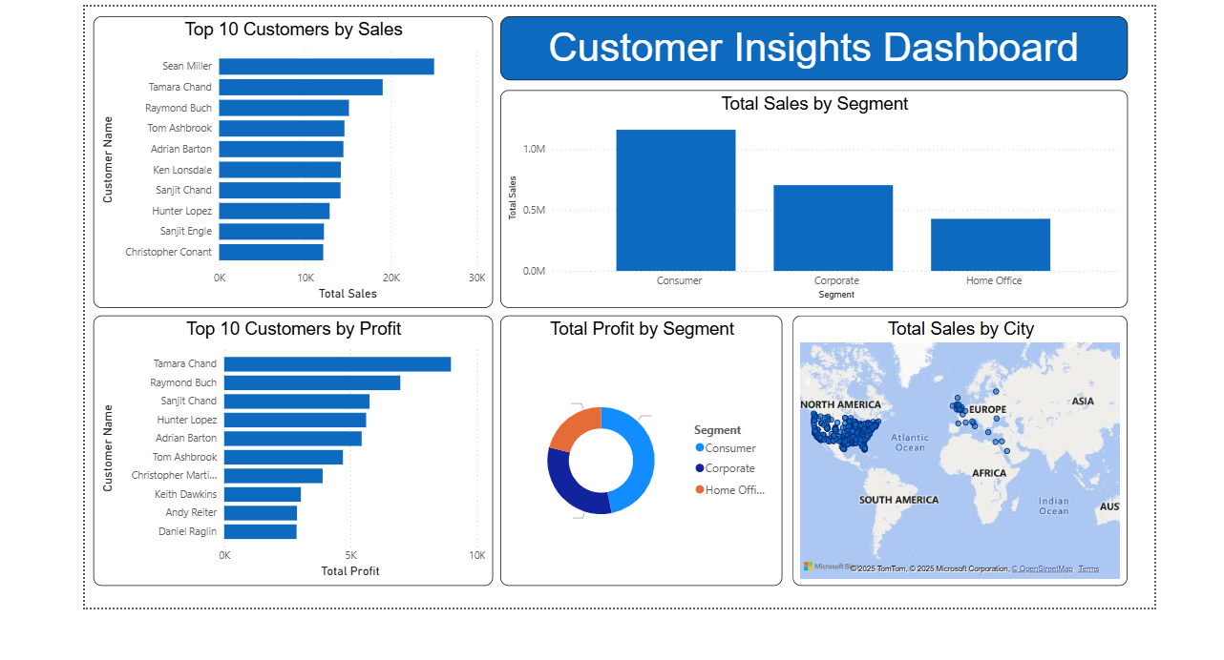
Customer Insights
Top customers: Sean Miller & Tamara Chand
Consumer segment = major revenue contributor
Corporate segment shows strong profit potential
High-value customers concentrated in specific regions
Home Office = smallest contributor → opportunity for growth

Slide 7
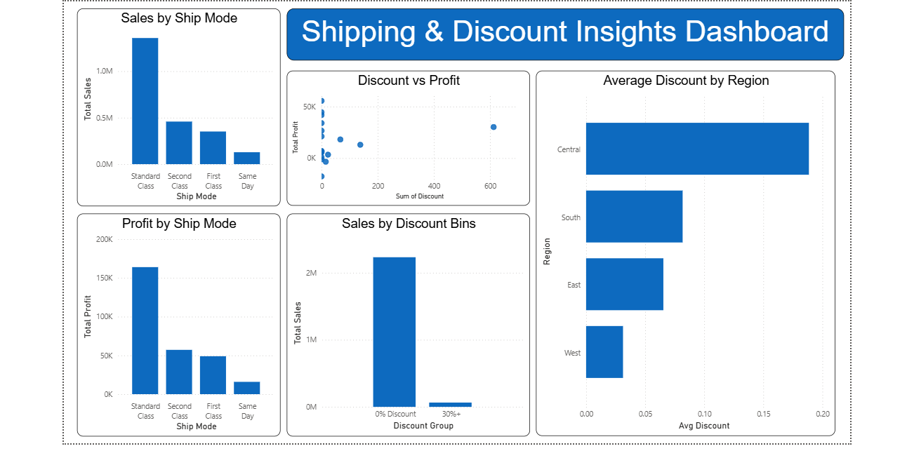
Shipping & Discount Insights
Standard Class dominates in Sales & Profit → customer preference
Same Day & First Class shipping cost reduces profit
High discounts → significant drop in profit
0–10% discount slab generates maximum revenue
Central region gives maximum discounts

Slide 8
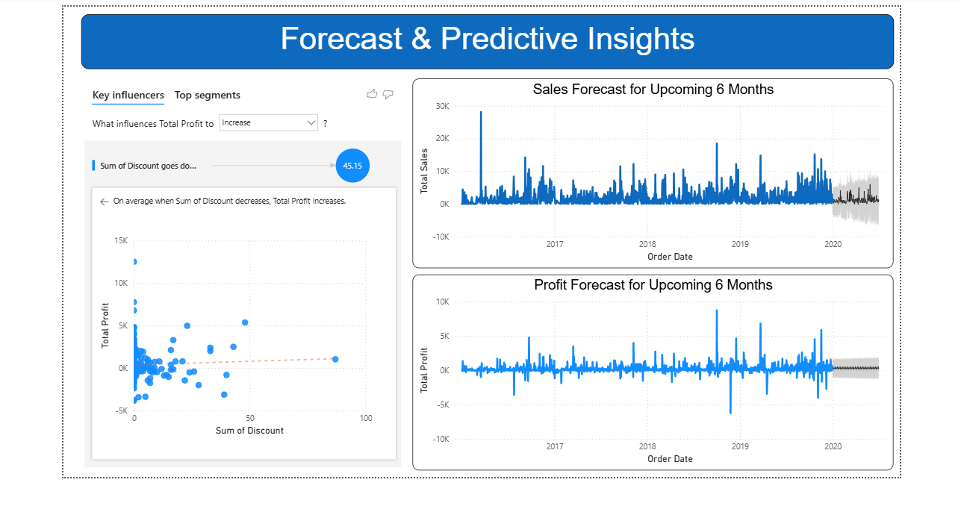
Forecast & Predictive Insights
Sales forecast predicts continuous business growth
Profit forecast shows improvement opportunities
Key drivers of profit = Discount, Sub-Category & Region
AI-based influencers help in cost optimization decisions

Slide 9
Business Recommendations
Reduce discounts on low-profit items
Improve furniture pricing or sourcing cost
Expand attractive offers in South & Central
Promote Standard Class as cost-effective shipping
Target high-value customers for retention

Slide 10
Conclusion
The dashboard provides a 360° view of business performance, enabling leadership to focus on profitable products, optimize discount strategy, and improve shipping efficiency for higher growth.

Slide 11
Thank You…
By : Divyam Mahant
LinkedIn — linkedin Profile
Email — divyammahant13@gmail.com

